Slide 1
Orthopedic 2B

Slide 2
TRAUMA AND INJURIES
To include:
Fractures
polytrauma
Nerve injuries
vascular injuries
Soft tissue injuries
sport injuries
Amputation

Slide 3
2. MULTIPLE(POLYTRAUMA)

Slide 4
Multiple(polytrauma)
polytrauma(Multiple trauma) is caused by a single catastrophic event that causes life-threatening injuries to at least two distinct organs or organ systems.
Patients with single-system trauma still receive
full assessment, because even single-system injuries can be life-threatening or more severe than they initially appear.

Slide 5
Mortality in patients with multiple trauma is related to the severity of the injuries and the number of systems and organs involved.
Immediately after injury, the body is hypermetabolic, hypercoagulable, and severely stressed.

Slide 6
Care of the patient with multiple injuries requires a team approach, with one person responsible for coordinating the treatment.
The nursing staff assumes responsibility of:
assessing and monitoring the patient, ensuring airway and IV `access,
administering prescribed medications,
collecting laboratory specimens, and
documenting activities and the patient’s subsequent responses.

Slide 7
Assessment and Diagnostic Findings
Evidence of trauma may be sparse or absent.
Patients with multiple trauma should be assumed to have a spinal cord injury until it is proven otherwise.
The injury regarded as the least significant in appearance may be the most lethal.

Slide 8
Assessment and Diagnostic Findings
For example, the pelvic fracture not identified until an x-ray is obtained may cause rapid and massive hemorrhage into the pelvic cavity, but an obvious amputation of the arm may have already stopped bleeding from the body’s normal response of vasoconstriction.

Slide 9
Assessment and Diagnostic Findings
The patient is observed for the following:
Hypovolemic shock resulting from extravasation of blood and plasma into injured tissues after compression has been released
Paralysis of a body part

Slide 10
Cont…….
Erythema and blistering of skin
Damaged body part (usually an extremity) appearing swollen, tense, and hard
Renal dysfunction (prolonged hypotension causes kidney damage and acute renal insufficiency; myoglobinuria secondary to muscle damage can cause acute tubular necrosis and acute renal failure)

Slide 11
Management
The goals of treatment are to determine the extent of injuries and to establish priorities of treatment.
Any injury interfering with a vital physiologic function (e.g., ABC)
Airway,
Breathing,
Circulation) is an immediate threat to life and has the highest priority for immediate treatment.

Slide 12
Management
Essential life-saving procedures are performed simultaneously by the emergency team.
As soon as the patient is resuscitated, clothes are removed or cut off and a rapid physical assessment is performed.
Transfer from field management to the ED must be orderly and controlled, with attention given to the verbal report from emergency medical services.
Treatment in a trauma center is appropriate for patients experiencing major trauma.

Slide 13
Management
In conjunction with maintaining the A B and C , the patient is observed for:
acute renal insufficiency - Injury to the back can cause kidney damage.
severe muscular damage - may cause rhabdomyolysis, which signifies a release of myoglobin from ischemic skeletal muscle, resulting in acute tubular necrosis.
major soft tissue injuries are splinted promptly to control bleeding and pain.

Slide 14
Medications for pain and anxiety are then administered
Patient is quickly transported to the operating suite for wound débridement and fracture repair.
A hyperbaric oxygen chamber (if available) may be used to hyperoxygenate crushed tissue

Slide 15
The serum lactic acid level is monitored; a decrease to less than 2.5 mmol/L is an indication of successful resuscitation
Injured extremity is elevated to relieve swelling and pressure.
Fasciotomy (ie, surgical incision to the level of the fascia) to restore neurovascular function done if compartment syndrome develops

Slide 16
3. NERVE INJURIES AND VASCULAR INJURIES

Slide 17
Introduction
Assessment of neurovascular status is essential for the early recognition of neurovascular deterioration or compromise.
Delays in recognising neurovascular compromise can lead to permanent deficits, loss of a limb and even death.
Neurovascular deterioration can occur late after trauma, surgery or cast application.

Slide 18
causes of nerve injuries and vascular injuries
Musculoskeletal trauma to the extremities
Fracture
Crush injury
Post-operative
Internal or external fixation or fractures
Orthopaedic surgery
Spinal surgery
Plastic surgery on extremities or phalanges
Cardiac catheterisation
Tourniquet applied for long periods

Slide 19
causes of nerve injuries and vascular injuries
Application of plaster cast
Restrictive dressing
Application of traction (skin and skeletal)
Burns patients
Circumferential burns
Signs of infection in the limb

Slide 20
Aim Assessment of neurovascular status
The aim of this clinical practice guideline is to outline the required neurovascular assessment to recognise early compromise and prevent permanent damage to the limb(s).

Slide 21
Definition of Terms
Muscle compartment: A well-defined space in the body that consists of a group of muscles in a particular segment, the muscle compartment is bound by fascia
Fasciotomy:
Surgical incision made through the fascia and into a compartment due to increasing pressure.
The aim of the procedure is to release pressure to improve peripheral neurovascular status and prevent long term complications.

Slide 22
Compartment syndrome: Increase in pressure of a closed muscle compartment that causes muscle and nerve ischemia.
Active movement: Ability to voluntarily extend and flex an extremity or digit.
Passive movement: Assessor able to extend and flex an extremity or digit

Slide 23
Neurovascular assessment
A neurovascular assessment is required for each affected limb and includes assessment of
Pain
Sensation
Motor function
Perfusion (colour, temperature, capillary refill, swelling, pulses)

Slide 24
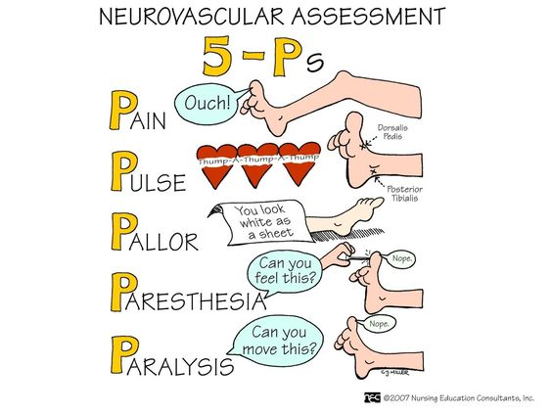
5-Ps Neurovascular assessment

Slide 25
Management
Ensure affected limb is elevated to minimise the risk of compartment syndrome.
Lower extremities can be elevated with pillows or using bed mechanics;
upper extremities can be elevated on either a pillow, sling or box sling.

Slide 26
Management of Neurovascular Compromise
Management include:
Elevate limb, no higher than heart level.
Split plaster, casts or cut/remove bandage.
Maintain limb alignment.
Notify surgeon and treating team.
If neurovascular status improves keep affected limb elevated and continue to monitor closely.
If neurovascular status does not improve or continues to deteriorate, the patient may need to go to theatre for pressure monitoring and fasciotomy.

Slide 27
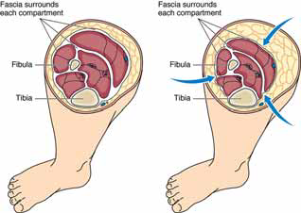
Compartment Syndrome

Slide 28
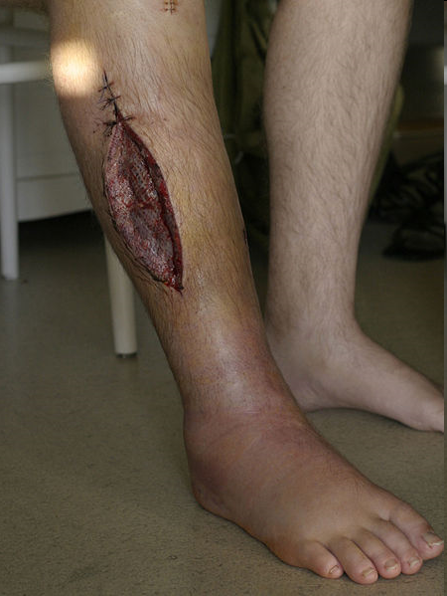
Fasciotomy may be performed to relieve pressure.
Pack and dress the wound after fasciotomy.

Slide 29
Frequency of observations
1 hourly for the first 24 hours post injury, surgery or application of cast.
Then 4 hourly for a further 48 hours or as specified by the treating medical team.
More frequently if any deviations from baseline observations.

Slide 30
Neurovascular complications
If neurovascular status is compromised, patients may report
decreased sensation,
loss of sensation,
dysesthesia,
numbness,
tingling or pins and needles.
Altered sensation may be a result of a nerve block
Notes:
dysesthesia,- painful, itchy, burning, or restrictive(“abnormal sensation.”)

Slide 31
4. SOFT TISSUE INJURIES

Slide 32
SOFT TISSUE INJURIES
Caused by the following
Contusion - bruising Injury caused by blunt force
Strain - Microscopic tear in the muscle caused by excessive Pull or stretching
Sprain - Injury from excessive stretching of a ligament surrounding a joint

Slide 33
SOFT TISSUE INJURIES
Contusion
- Injury caused by blunt force, such as a blow, kick, or fall.
Many small blood vessels rupture and bleed into soft tissues (ecchymosis, or bruising). A hematoma may develop.
Local symptoms (pain, swelling, and discoloration) are controlled with intermittent application of cold.
Most resolve in 1 to 2 weeks.

Slide 34
A strain
Microscopic tear in the muscle―Pulled muscle
A “muscle pull” caused by overuse, overstretching, or excessive stress.
Strains are microscopic, incomplete muscle tears with some bleeding into the tissue.
The patient experiences soreness or sudden pain, with local tenderness on muscle use and isometric contraction.

Slide 35
A sprain
Ligament injury (Excessive stretching of a ligament)
Injury to the ligaments surrounding a joint caused by:
wrenching - twisting suddenly and violently or pulling
A torn ligament loses its stabilizing ability.
Blood vessels rupture and edema occurs; the joint is tender, and movement of the joint becomes painful.
Notes:
wrenching
1.
wrenching ---pull or twist suddenly and violently.

Slide 36
Cont’d…
The degree of disability and pain increases during the first 2 to 3 hours after the injury because of the associated swelling and bleeding.
An x-ray should be obtained to rule out bone injury.
Avulsion fracture (in which a bone fragment is pulled away by a ligament or tendon) may be associated with a sprain.

Slide 37
Sprain grading
Grade I—mild bleeding and inflammation
Grade II—severe stretching and some tearing and inflammation and hematoma
Grade III—complete tearing of ligament
Grade IV—bony attachment of ligament broken away

Slide 38
Sprains
Treatment of sprains:
first-degree: rest, ice for 24 to 48 hr, compression bandage, and elevation
second-degree: immobilization, partial weight bearing as tear heals
third-degree and 4th degree: immobilization for 4 to 6 weeks, possible surgery

Slide 39
Soft Tissue Injury Step-By-Step Trauma Mngt
AIM: To decrease swelling and pain, and
encourage rest
Treatment of contusions, strains, and sprains consists of the acronym RICE—Rest, Ice, Compression, Elevation)
R=Stop the activity immediately. Splint to support extremities and limit movement
I=Apply ice to the injured part for 10 to 15 minutes for first 48 hours. Let the area warm completely before applying ice again to prevent frost bite

Slide 40
Soft Tissue Injury Step-By-Step Trauma Mngt
C=Wrap the injured part in a elastic compression bandage/Compression dressing
E=Elevate the injured part to increase venous return and reduce swelling.
NSAIDs
See a physician for a proper diagnosis of any serious injury.

Slide 41
Management
Rest prevents additional injury and promotes healing.
Moist or dry cold compression applied intermittently for 20 -30 minutes during the first 24 to 48 hours after injury produces vasoconstriction, which decreases bleeding, edema, and discomfort.
Care must be taken to avoid skin and tissue damage from excessive cold.

Slide 42
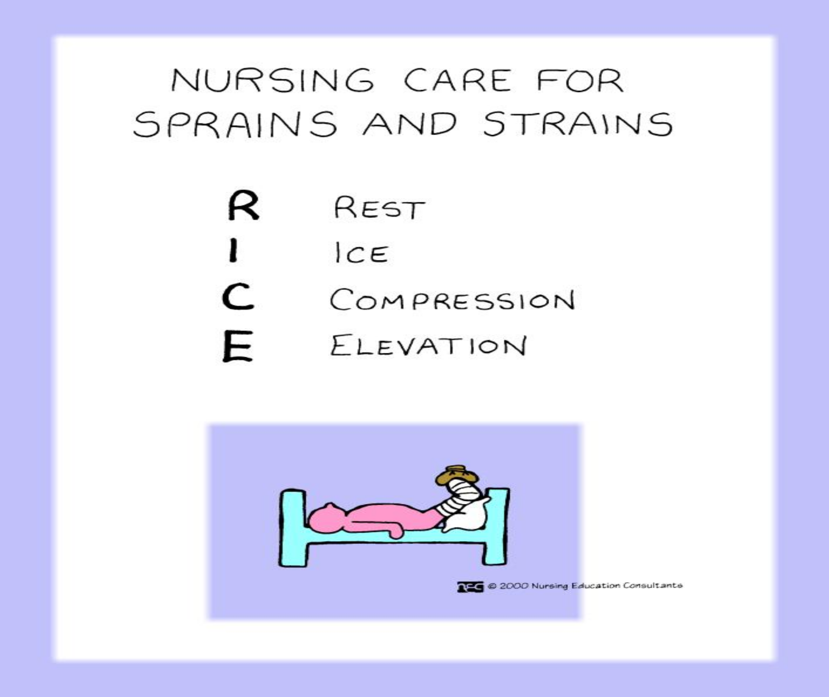

Slide 43
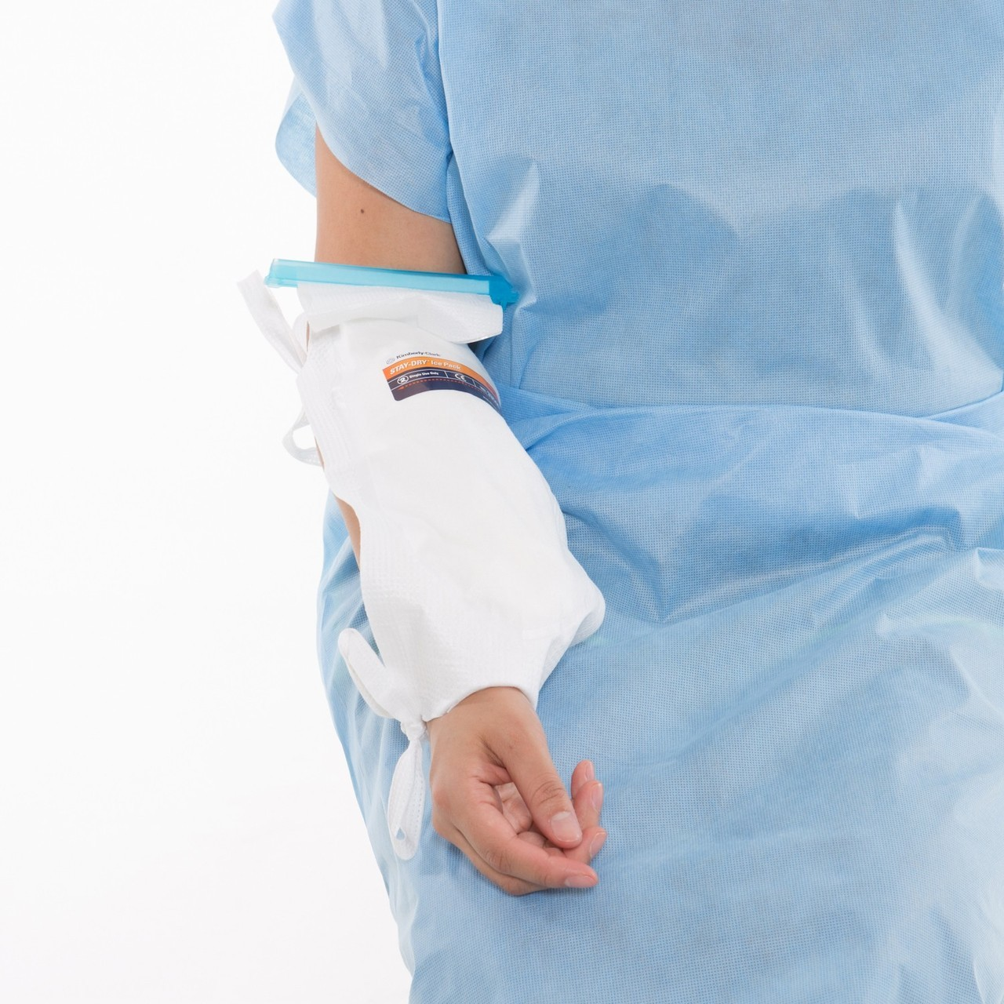
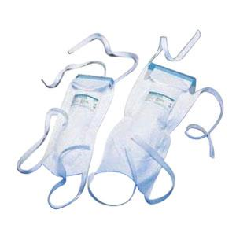
Icepacks

Slide 44
5. SPORTS-RELATED INJURIES

Slide 45

Sports

Slide 46
Sports-Related Injuries
Sport activities are very common, and, unfortunately, sports related injuries are also common consequences.

Slide 47
Different Types of Sports Injuries
These injuries may be classified as acute or chronic.
Acute injuries are those injuries that occur suddenly.
Chronic injuries happen over time and are also commonly called overuse injuries.

Slide 48
Different Types of Sports Injuries
It is important to have knowledge of first aid procedures.
first aid supplies include
Ice packs,
Bandages,
A finger splint,
Hand sanitizer
Alcohol wipes

Slide 49
First Aid for Acute Sports Injuries
The most common acute sports-related injuries vary by age.
younger athletes are at higher risk for
fractures and
dislocations.
Concussions – traumatic brain injury due blow
For who participate in contact sports such as football, rugby, ice hockey, and wrestling (for males) and soccer and basketball (for females)
Notes:
A concussion is a traumatic brain injury that affects your brain function. Concussions are usually caused by a blow to the head. violent shaking of the head and body.

Slide 50
common acute sports injuries include:
Dislocations
Fractures
Knee injuries
Rotator cuff injuries
Sprains and strains
Notes:
Rotator cuff injuries

Slide 51
Common symptoms of acute injuries include
Bone or joint that is visibly out of place- fxture
cuts and abrasions
Extreme leg or arm weakness
Joint weakness or inability to move a joint
Not being able to place weight on a leg, knee, ankle, or foot
Sudden pain and swelling

Slide 52
Management
Non- Invasive procedures
Many Sport-related problems can be successfully treated without surgery, as surgery is rarely the first line of treatment for most patients.
PRICE Therapy
If your injury does not require medical treatment, for example a mild sprain or other minor muscle or ligament damage, you can treat it at home using PRICE therapy.
PRICE stands for:
Protect the injured area from further injury,for example ,by using a support ,or in the case of an ankle injury ,wearing shoes that enclose and support your feet ,such as lace ups.

Slide 53
Management
Rest: avoid regular exercise and reduce daily physical activity.
Using crutches or a walking stick may help if you are unable to put weight on your ankle or knee.
Ice: apply an ice pack to the affected area for 10 to 30 minutes. Do not allow the ice to touch your skin directly as this may cause a cold burn. Before applying ice, wrap it in a wet towel or put a wet towel over the injured area.

Slide 54
Management
Compression: apply pressure (compression) using elastic compression bandages. This may help to limit swelling.
Elevation: keep the injured leg, knee, arm, elbow or wrist raised above the level of the heart as this may also help reduce swelling.
After 48 hours of PRICE therapy, stop compression and try moving the injured area.
If, after this time, your symptoms are worse, get advice from a healthcare professional.

Slide 55
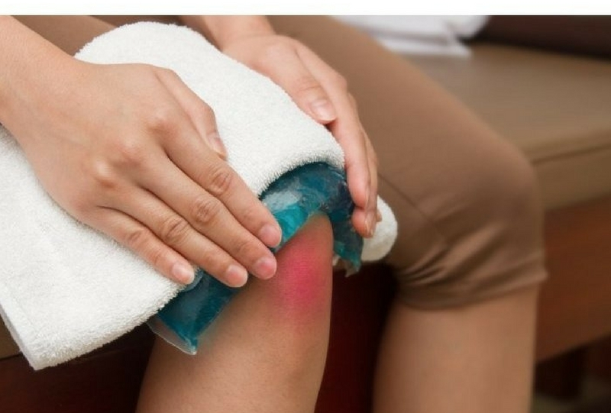
wet towel put over the injured area.

Slide 56
Management
Viscosupplementation: A fluid naturally occurring in human joints that coats and lubricates the joint .
Hyaluronate (acts as a lubricant) is injected into the joint easing the pain of moderate to severe degenerative arthritis

Slide 57
Steroid Injections:
Non-surgical pain management and critical to successful long-term management of recurrent back and joint pain.
These injections offer immediate relief for severe pain.
Ultrasound Guided Hip Injections: For the athlete that develops hip pain from running or overuse to the arthritic hip,

Slide 58
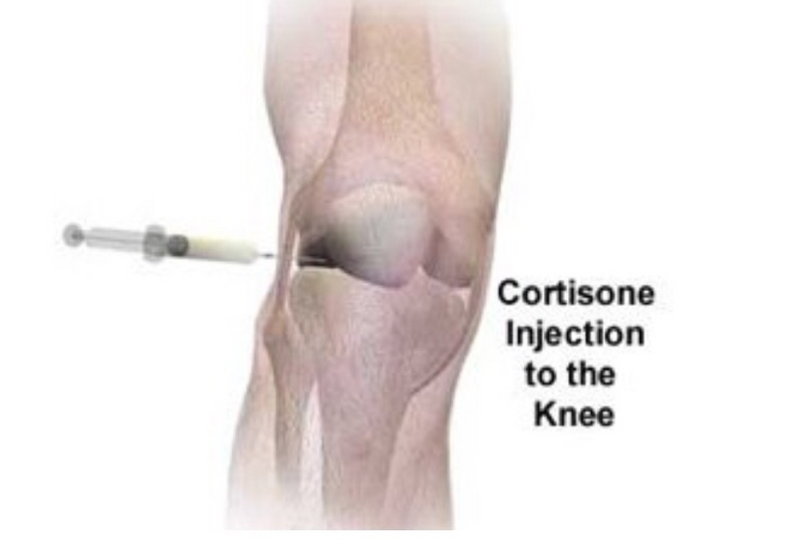
Steroid Injections:

Slide 59
Physical Therapy
The goal of physical therapy treatments is to help patients return to complete independence as soon as possible.
Physicians concentrate on prescribing physical therapy exercises.
These exercises enable patients to resume regular movement and control inflammation
Massage using the hands to apply pressure to the affected area - encourage blood to flow to the site of the injury to help the healing process

Slide 60
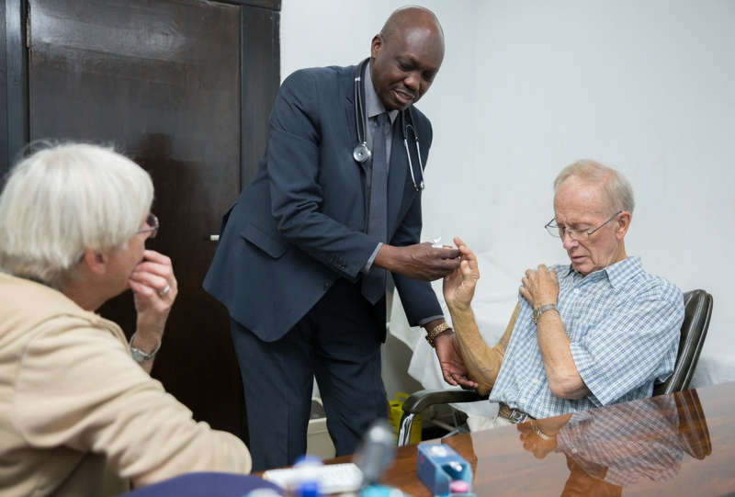
Physical Therapy

Slide 61
Physical Therapy
Motivate pt to return to their previous level of activity.
Compliance with restriction of activities
gradual resumption of activities need to be reinforced.
Injured athletes are at risk for re injury and require follow-up and monitoring.

Slide 62
Diminish level and intensity of activity to a comfortable level.
Gradual increase of activities to acclimate the muscles, tendons, and joints to the sport motions will assist in recovery and rehabilitation.
Notes:
Acclimate= adoption to a change in its environment, allowing it to maintain performance across a range of environmental conditions.

Slide 63
Prevention Sports-related injuries
using proper equipment (eg, running shoes for joggers, wrist guards for skaters) and
effectively training and conditioning the body.
Specific training needs to be tailored to the person and the sport.

Slide 64
END
THANKS

Slide 65
6. AMPUTATION

Slide 66
Definition
Amputation is the removal of limb, part or total from the body.
Disarticulation is removing the limb through a joint
Generally the amputation of Lower Limb are more common than those of upper limb.

Slide 67
Indications of Amputation
Trauma – RTA,
Gun shot
Malignant tumors
Nerve injuries & infection
Extreme heat & cold – burn, gangrene
Peripheral vascular insufficiency
Congenital absence of limbs or malformation
Severe infection

Slide 68
Cont…..
Of all these causes, peripheral vascular disease accounts for most amputations of lower extremities
Amputation of an upper extremity occurs less frequently than a lower extremity and is most often necessary because of either traumatic injury or a malignant tumor.

Slide 69
Principle consideration to amputate
Preservation of life - to save life
Improvement of general health-improve the patient’s quality of life.
Restoration of function or to improve function
Reduction of pain and other symptoms

Slide 70
Causes of Amputation
Natural causes e.g. Congenital absence, Arterial disease, Frostbite, Wound infections, Diabetes mellitus, Dietary deficiencies
Accidental causes
Falls when running or from heights
Crushing by trees
Savaging by crocodiles and sharks
Effects of earthquakes, tsunamis and Violent storms

Slide 71
Ritual, Punitive & Legal Amputations
Curing local pain
In removing deformity
Infection or gangrene
In saving lives
Cold steel & Gunshot causes
Iron & steel weapons evolved fingers & hands
Destructive gunshot wounding

Slide 72
Types of amputation
Closed Amputation
Open Amputation (Guillotine Operation)

Slide 73
Closed Amputation
It is done as an elective procedure
After amputations, the soft tissues are closed primarily over the bony stump. E.g., above knee, below knee etc.

Slide 74
Open Amputation (Guillotine Operation)
It is done as an emergency procedure. E.g. life threatening infections
After amputations, the wound is left open & not closed.

Slide 75
Levels of Amputation
Amputation is performed at the most distal point that will heal successfully.
The site of amputation is determined by two factors:
Circulation in the part
functional usefulness (i.e., meets the requirements for the use of a prosthesis).

Slide 76
The circulatory status of the extremity is evaluated through
physical examination and diagnostic studies.
Doppler flow studies with duplex ultrasound
segmental blood pressure determinations
transcutaneous PaO2 of the extremity
Angiography is performed if revascularization is considered an option.
NB:Muscle and skin perfusion is important for healing.

Slide 77
The objective of surgery is to conserve as much extremity length as needed to preserve function and possibly to achieve a good prosthetic fit. Preservation of knee and elbow joints is desirable.
Most amputations involving extremities can be eventually fitted with a prosthesis.
The amputation of toes and portions of the foot can cause changes in gait and balance.

Slide 78
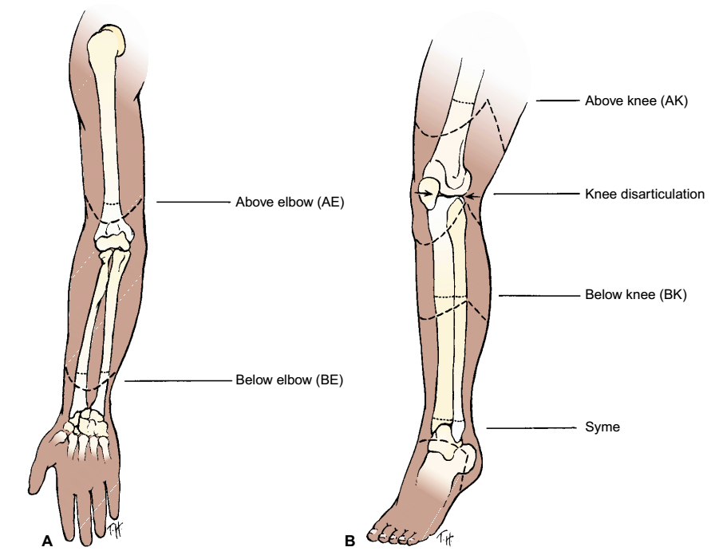
Levels of Amputation

Slide 79
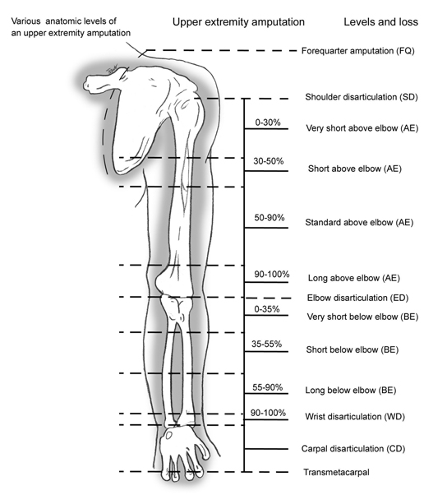
Levels of Amputation

Slide 80
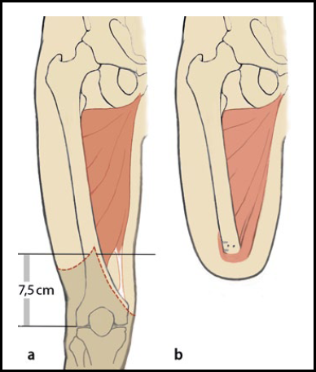
Above knee amputation

Slide 81
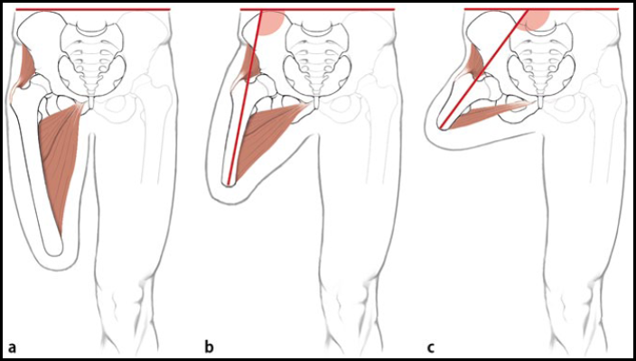
Above knee amputation
Levels of Amputation

Slide 82
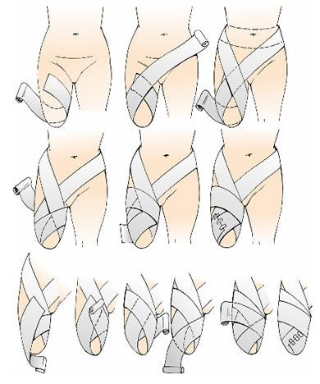

Slide 83
A Syme amputation (modified ankle disarticulation amputation) is performed most frequently for extensive foot trauma and aims to produce a durable extremity end that can withstand full weight bearing.
Below-knee amputation (BKA) is preferred to above-knee amputation (AKA) because of the importance of the knee joint and the energy requirements for walking.

Slide 84
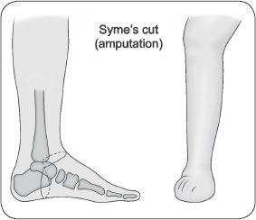

Slide 85
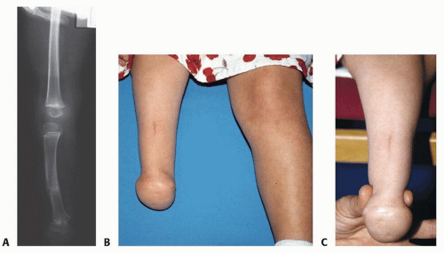
Syme amputation

Slide 86
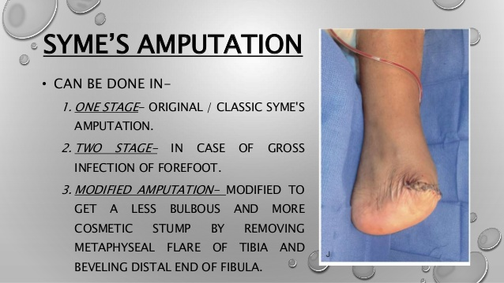

Slide 87
Knee disarticulations are most successful with young, active patients who can develop precise control of the prosthesis.
When AKAs are performed, all possible length is preserved, muscles are stabilized and shaped, and hip contractures are prevented to maximize ambulatory potential.
Most people who have a hip disarticulation amputation must rely on a wheelchair for mobility.
Notes:
Hip disarticulation is the amputation of the entire lower limb at the hip level

Slide 88
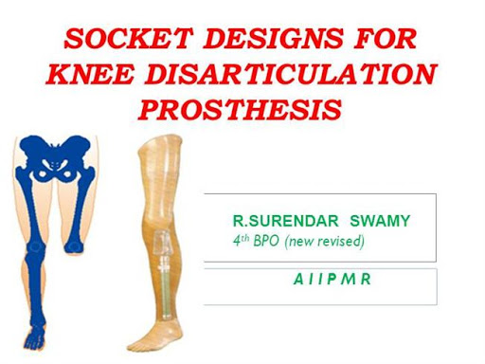

Slide 89
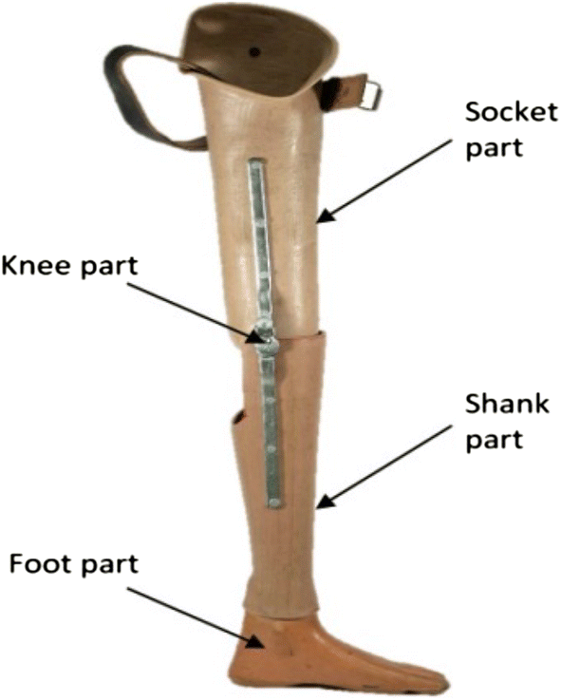
Knee disarticulation prosthesis

Slide 90
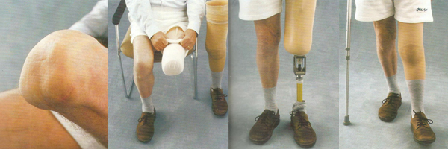
Knee disarticulation prosthesis

Slide 91
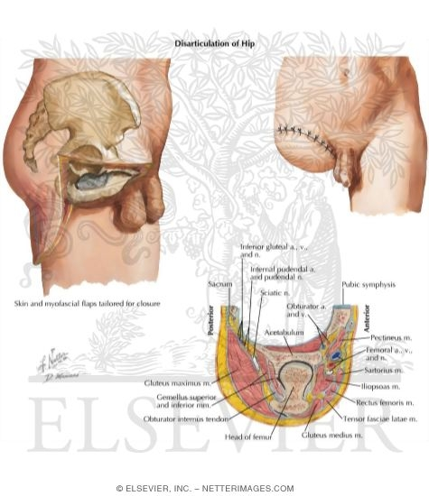
hip disarticulation amputation

Slide 92

hip disarticulation amputation

Slide 93
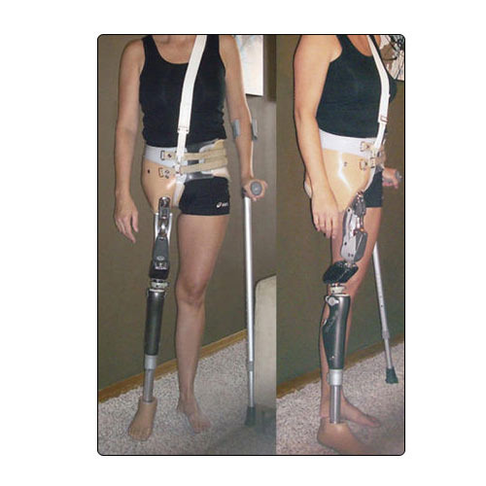
hip disarticulation amputation

Slide 94
Upper extremity amputations are performed with the goal of preserving maximal functional length.
The prosthesis is fitted early to ensure maximum function.
A staged amputation may be used when gangrene and infection exist.
Initially, a guillotine amputation (eg, nonclosed residual limb) is performed to remove the necrotic and infected tissue
Notes:
guillotine amputation is an amputation performed without closure of the skin in an urgent setting. Amputation that is preformed over the course of several operations, usually to control the spread of infection or necrosis.

Slide 95
The wound is débrided and allowed to drain.
Sepsis is treated with systemic antibiotics.
In a few days, after the infection has been controlled and the patient’s condition has stabilized, a definitive amputation with skin closure is performed.

Slide 96
Complication of amputation
Haematomas
Necrosis
Stump pain
Hyperesthesia of stump - excessive physical sensitivity, especially of the skin.
Stump edema
Bone overgrowth
Causalgia- severe burning pain in a limb caused by injury to a peripheral nerve.

Slide 97
Complications
hemorrhage - Because major blood vessels have been severed, massive bleeding may occur.
Infection - risk with all surgical procedures.
skin breakdown,
phantom limb pain,
joint contracture.

Slide 98
The risk of infection increases with contaminated wounds after traumatic amputation.
Skin irritation caused by the prosthesis may result in skin breakdown.
Phantom limb pain is caused by the severing of peripheral nerves.
Joint contracture is caused by positioning and a protective flexion withdrawal pattern associated with pain and muscle imbalance.

Slide 99
Assignment
Make notes on Complications of amputation

Slide 100
Phantom Limb Pain
Occurs after surgical or traumatic amputation of a limb.
Client experiences pain in the missing body part even though he is aware that the limb is gone.
Pain may include itching, tingling, or pressure sensations, or it may be more severe, including burning or stabbing sensations.

Slide 101
It may be due to stimulation of the severed nerves at the site of the amputation.
Client complains of pain at the site of the removed body part, most often shortly after surgery.
Some clients feel that the removed body part is in a distorted position.

Slide 102
Management of Phantom Pain
Phantom limb pain must be distinguished from stump pain because they are managed differently.
Recognize that this pain is real and interferes with the amputee's activities of daily living.

Slide 103
Management of Phantom Pain
Some studies have shown that opioids are not as effective for phantom limb pain as they are for residual limb pain.
Other drugs include intravenous infusion calcitonin, beta blockers, anticonvulsants, and antispasmodics.

Slide 104
Amputation care
Nursing Management goals
relieving pain
minimizing altered sensory perception
promoting wound healing
enhancing body image
self-care

Slide 105
Pre-operative Care
Evaluate the neurovascular and functional status of the extremity, the nutritional status.
Any concurrent health problems e.g, cardiac insufficiency, chronic respiratory problems, diabetes mellitus.
Assist the patient to undergo investigations, i.e blood grouping and cross-matching, blood culture

Slide 106
Cont’d…
Assesses the patient’s psychological status: emotional reaction, change in body image.
Always give good nutrition, high in vitamins and proteins
Correct and monitor Hb
Teach the patient how to use assistive devices such as crutches
Involve the patient in exercise programs.

Slide 107
Post-operative Care Management
The objective of treatment is to achieve healing of the amputation wound, the result being a non tender residual limb with healthy skin for prosthetic use.
Healing is enhanced by gentle handling of the residual limb, control of residual limb edema through rigid or soft compression dressings, and use of aseptic technique in wound care to avoid infection.

Slide 108
Post-operative Care
Control surgical pain with opioid analgesics i.e. pethidine
Closely monitor pt for hemorrhages, vital signs fluctuations
Ensure good wound drainage, proper wound dressing
Administration of antibiotics to decrease sepsis

Slide 109
Cont’d…
Physiotherapy to prevent the development of contractures.
Care of the skin at the stump area,
Enhance physical mobility by muscle strengthening and ROM exercise, position changes, elevation.

Slide 110
Enhance healing: gentle handling of the residual limb, control of residual limb edema(rigid or soft compression dressings)
use of aseptic technique in wound care to avoid infection.
Education on use of prostheses.

Slide 111
A closed rigid cast, dressing or an elastic residual limb shrinker that covers the residual limb may be used to provide:
uniform compression
to support soft tissues,
to control pain, and
to prevent joint contractures.
This rigid dressing technique is used as a means of creating a socket for immediate postoperative prosthetic fitting.

Slide 112
The length of the prosthesis is tailored to the individual patient.
Early minimal weight bearing on the residual limb with a rigid cast dressing produces little discomfort.
The cast is changed in about 10 to 14 days.
Fever, severe pain, or a loose-fitting cast may necessitate earlier replacement.

Slide 113
A removable rigid dressing may be placed over a soft dressing to control edema, to prevent joint flexion contracture, and to protect the residual limb from unintentional trauma during transfer activities.
This rigid dressing is removed several days after surgery for wound inspection
Rigid dressing replaced to:
control edema.
Facilitates residual limb shaping.

Slide 114
A soft dressing with or without compression may be used if there is significant wound drainage
Frequent inspection of the residual limb is required.
Residual limb wound hematomas are controlled with wound drainage devices to minimize infection e.g. Penrose tube.
Monitor for potential complication i.e. infections

Slide 115
Exercise After Amputation
ROM to prevent flexion contractures, particularly of the hip and knee
Trapeze and overhead frame
Firm mattress
Prone position every 3 to 4 hours
Elevation of lower-leg residual limb controversial

Slide 116
Rehabilitation
The multidisciplinary rehabilitation team include(patient, nurse, physician, social worker, physical therapist, occupational therapist, psychologist, prosthetist, vocational rehabilitation worker) helps the patient achieve the highest possible level of function and participation in life activities
Prosthetic clinics and amputee support groups facilitate this rehabilitation process

Slide 117
Rehabilitation of the patient
psychological support in accepting the sudden change in body image in accepting the sudden change in body image
The patient is encouraged to be an active participant in self-care. physically be able to participate in a vigorous rehabilitation program.
dealing with the stresses of hospitalization,
Modification of lifestyle.

Slide 118
need support as they grieve the loss and change in body image. Their reactions can include anger, bitterness, and hostility.
Psychological issues (eg, denial, withdrawal) may be influenced by the type of support the patient receives from the rehabilitation team and by how quickly ADLs and use of the prosthesis are learned.
Knowing the full options and capabilities available with the various prosthetic devices can give the patient a sense of control over the resulting disability

Slide 119
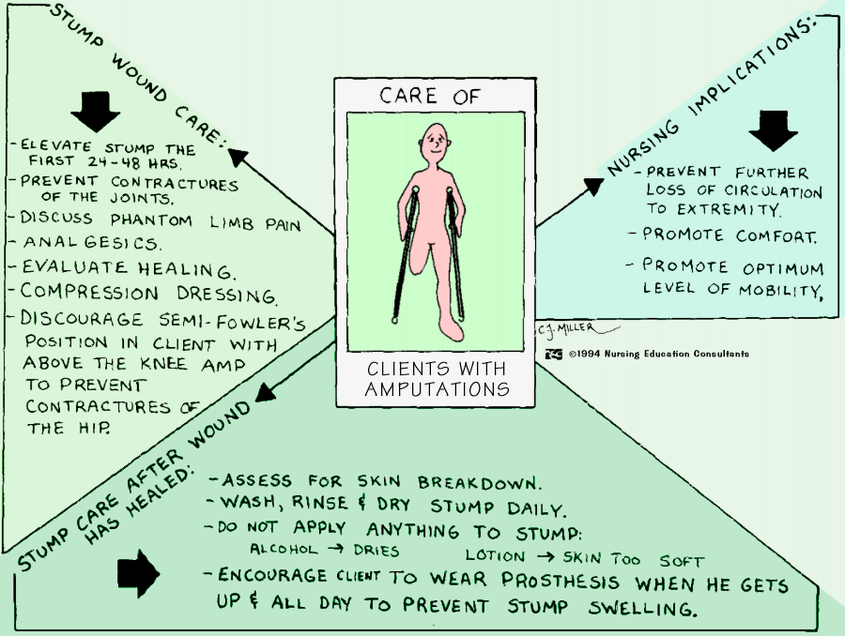

Slide 120
Prostheses
Devices to help shape and shrink the residual limb and help client readapt to life
Wrapping of elastic bandages shapes the stump for fitting into a prostheses
Individual fitting of the prosthesis; special care

Slide 121
NURSING PROCESS THE PATIENT UNDERGOING AN AMPUTATION
Assessment
Before surgery, the nurse must evaluate the neurovascular and functional status of the extremity through history and physical assessment.
If the patient has experienced a traumatic amputation, the nurse assesses the function and condition of the residual limb.

Slide 122
The nurse also assesses the circulatory status and function of the unaffected extremity.
If infection or gangrene develops, the patient may have associated enlarged lymph nodes, fever, and purulent drainage.

Slide 123
A culture and sensitivity test is obtained to determine the appropriate antibiotic therapy.
The nurse evaluates the patient’s nutritional status and develops a plan for nutritional care in consultation with a dietitian or metabolic support team, if indicated.
A diet with adequate protein and vitamins is essential to promote wound healing.

Slide 124
Any concurrent health problems (eg, dehydration, anemia, cardiac insufficiency, chronic respiratory problems, diabetes mellitus) need to be identified and treated so that the patient is in the best possible condition to withstand the surgical procedure.
The use of corticosteroids, anticoagulants, vasoconstrictors, or vasodilators may influence management and prolong or delay wound healing.

Slide 125
The nurse assesses the patient’s psychological status.
Evaluation of the patient’s emotional reaction to amputation is important.
Grief responses to permanent alterations in body image, function, and mobility are likely.
Professional counseling can help the patient cope in the aftermath of amputation surgery.

Slide 126
Diagnosis Nursing Diagnoses
Based on the assessment data, the patient’s major nursing
diagnoses may include the following:
Acute pain related to amputation
Disturbed sensory perception: phantom limb pain related
to amputation
Impaired skin integrity related to surgical amputation

Slide 127
Disturbed body image related to amputation of body
part
Grieving and/or risk for complicated grieving related
to loss of body part and resulting disability
Self-care deficit: feeding, bathing/hygiene, dressing/
grooming, or toileting, related to loss of extremity
Impaired physical mobility related to loss of extremity

Slide 128
Collaborative Problems/Potential Complications
Based on the assessment data, potential complications that may develop include the following:
• Postoperative hemorrhage
• Infection
• Skin breakdown

Slide 129
Planning and Goals
The major goals of the patient may include
relief of pain,
absence of altered sensory perceptions,
wound healing,
acceptance of altered body image,
resolution of the grieving process,
independence in self-care,
restoration of physical mobility, and
absence of complications.

Slide 130
Nursing Interventions
Relieving Pain
Pain may be incisional or may be caused by inflammation, infection, pressure on a bony prominence, or hematoma.
Muscle spasms may add to the patient’s discomfort.
Surgical pain can be effectively controlled with opioid analgesics that may be accompanied with evacuation of a hematoma or accumulated fluid.

Slide 131
Changing the patient’s position or placing a light sandbag on the residual limb to counteract the muscle spasm may improve the patient’s level of comfort.
Evaluation of the patient’s pain and responses to interventions is an important component of pain management.
The pain may be an expression of grief and alteration of body image.

Slide 132
Minimizing Altered Sensory Perceptions
A person who has had an amputation may begin to experience phantom limb pain soon after surgery or 2 to 3 months after amputation.
It occurs more frequently in patients who have had AKAs.
The patient describes pain or unusual sensations,
such as numbness, tingling, or muscle cramps, as
well as a feeling that the extremity is present, crushed, cramped, or twisted in an abnormal position.

Slide 133
When a patient describes phantom pains or sensations, the nurse acknowledges these feelings as real and encourages the patient to verbalize when in pain so that effective treatment may be given.
Although phantom sensations diminish over time for many patients, they do not occur in all patients with amputations

Slide 134
The pathogenesis of the phantom limb phenomenon is unknown.
Keeping the patient active helps decrease the occurrence of phantom limb pain.
Early intensive rehabilitation and residual limb desensitization with kneading massage bring relief.

Slide 135
Distraction techniques and activity are helpful.
Transcutaneous electrical nerve stimulation (TENS), ultrasound, or
Local anesthetics may provide relief for some patients.

Slide 136
Beta-blockers may relieve dull, burning discomfort;
Antiseizure medications control stabbing and cramping pain; and
Tricyclic antidepressants may not only alleviate phantom pain, they may also be prescribed to improve mood and coping ability.

Slide 137
Promoting Wound Healing
The residual limb must be handled gently.
Whenever the dressing is changed, aseptic technique is required to prevent wound infection and possible osteomyelitis
Residual limb shaping is important for prosthesis fitting.

Slide 138
The nurse instructs the patient and family to apply elastic wraps on the residual limb.
Using ace wraps on the residual limb is discouraged because they may apply inconsistent pressure on the residual limb, causing problems with shaping it to fit a prosthetic.
After the incision is healed, the patient is instructed how to care for the residual limb.

Slide 139
Enhancing Body Image
Amputation is a procedure that alters the patient’s body image.
The nurse who has established a trusting relationship with the patient is better able to communicate acceptance of the patient who has experienced an amputation.
The nurse encourages the patient to look at, feel, and care for the residual limb.

Slide 140
It is important to identify the patient’s strengths and resources to facilitate rehabilitation.
The nurse helps the patient regain the previous level of independent functioning.

Slide 141
The patient who is accepted as a whole person is more readily able to resume responsibility for self-care; self-concept improves, and body-image changes are accepted.
Even with highly motivated patients, this process may take months.

Slide 142
Helping the Patient to Resolve Grieving
The loss of an extremity (or part of one) may come as a shock even if the patient was prepared preoperatively.
The patient’s behavior (eg, crying, withdrawal, apathy, anger) and expressed feelings (eg, depression, fear, helplessness) reveal how the patient is coping with the loss and working
through the grieving process.

Slide 143
The nurse creates an accepting and supportive atmosphere in which the patient and family are encouraged to express and share their feelings and work through the grief process.
The support from family and friends promotes the patient’s acceptance of the loss.

Slide 144
The nurse helps the patient deal with immediate needs and become oriented to realistic rehabilitation goals and future independent functioning.
Mental health and support group referrals may be appropriate

Slide 145
Promoting Independent Self-Care
Amputation of an extremity affects the patient’s ability to provide adequate self-care.
The patient is encouraged to be an active participant in self-care.
The patient needs time to accomplish these tasks and must not be rushed.
Practicing an activity with consistent, supportive supervision in a relaxed environment enables the patient to learn self-care skills.

Slide 146
The patient and the nurse need to maintain positive attitudes and to minimize fatigue and frustration during the learning process.
Independence in dressing, toileting, and bathing depends on balance, transfer abilities, and physiologic tolerance of the activities.

Slide 147
The nurse works with the physical therapist and occupational therapist to teach and supervise the patient in these self-care activities.
The patient with an upper extremity amputation has self-care deficits in feeding, bathing, and dressing.

Slide 148
Assistance is provided only as needed; the nurse encourages the patient to learn to do these tasks, using assistive feeding and dressing aids when needed.
The nurse, therapists, and prosthetist work with the patient to achieve maximum independence.

Slide 149
Helping the Patient to Achieve Physical Mobility
Proper positioning prevents the development of hip or knee
joint contracture in the patient with a lower extremity amputation.
Abduction, external rotation, and flexion of the lower extremity are avoided.
The residual limb may be placed in an extended position or elevated for a brief period after surgery.

Slide 150
The nurse encourages the patient to turn from side to side and to assume a prone position, if possible, to stretch the flexor muscles and to prevent flexion contracture of the hip.
The patient is encouraged not to sit for long periods of time to prevent flexion contracture.

Slide 151
The legs should remain close together to prevent an abduction deformity.
The nurse encourages the patient to use assistive devices to more readily perform self-care activities and to identify what home modifications, if any, should be made to perform these activities in the home environment.

Slide 152
Postoperative ROM exercises are started early because contracture deformities develop rapidly. ROM exercises include hip and knee exercises for patients with BKAs and hip exercises for patients with AKAs.
It is important that the patient understand the importance of exercising the residual limb.

Slide 153
Evaluation
Expected Patient Outcomes
Expected patient outcomes may include:
1. Experiences no pain
a. Appears relaxed
b. Verbalizes comfort
c. Uses measures to increase comfort
d. Participates in self-care and rehabilitative activities
2. Experiences no phantom limb pain
a. Reports diminished phantom sensations
b. Uses distraction techniques
c. Performs residual limb desensitization massage

Slide 154
END
Thanks

